Slide 1
Snowflake Training

Slide 2
Agenda
Data Loading & Unloading
Considerations
Best Practices
LAB
Common Table Expression
Sequence
LAB
Semi Structured Data
Considerations
Best Practices
LAB
Time Travel & Fail Safe
Caching
LAB
Day 2

Slide 3
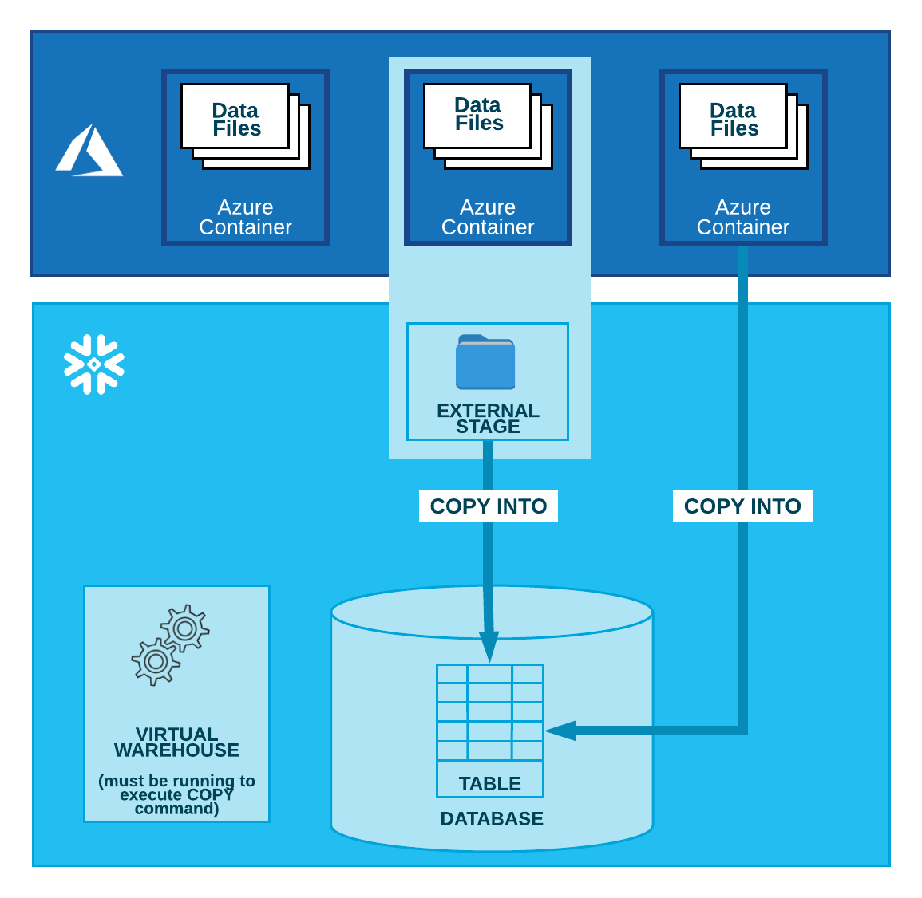
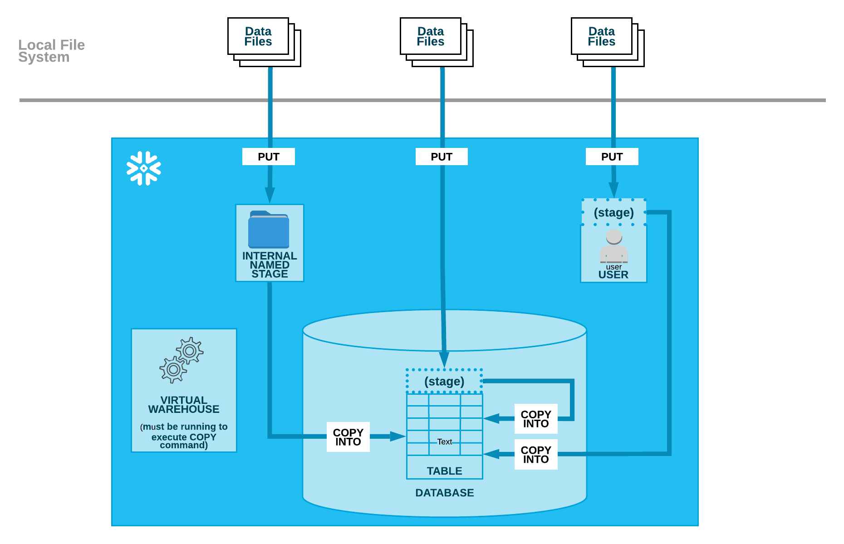
BULK loading
COPY INTO is the bulk load utility.
Bulk load can be done from local file system or a cloud storage.
A named external stage is a database object created in a schema. This object stores the URL to files in cloud storage.
Notes:
select get_ddl('table', 'mydb.public.salesorders’);
Temporary tables only exist within the session in which they were created and persist only for the remainder of the session.
This means you can create temporary and non-temporary tables with the same name within the same schema.
If the Time Travel retention period for a permanent table is set to 0, it will immediately enter the Fail-safe period when it is dropped.
Transient and temporary tables have no Fail-safe period.
Materialized views are automatically and transparently maintained by SnowflakeFor non-materialized views, the IS_SECURE column in the Information Schema and Account Usage views identifies whether a view is secure.
Snowflake does not allow standard DML (e.g. INSERT, UPDATE, DELETE) on materialized views. Snowflake does not allow users to truncate materialized views.

Slide 4
BULK load – Considerations and Best Practices
Snowflake’s support for Azure cloud - Blob storage, Data Lake Storage Gen2, General-purpose v1, General-purpose v2
~ 100-250 MB (compressed ) are the recommended file sizes.
Data loading operation is allowed for a maximum duration of 24 hours.
Aggregate smaller files to minimize the processing overhead for each file.
Organize data files by Path - @%t1/United_States/California/Los_Angeles/2016/06/01/11/mydata
Use the COPY_HISTORY to check if the data has been loaded successfully. ( STATUS column )
Notes:
select get_ddl('table', 'mydb.public.salesorders’);
Temporary tables only exist within the session in which they were created and persist only for the remainder of the session.
This means you can create temporary and non-temporary tables with the same name within the same schema.
If the Time Travel retention period for a permanent table is set to 0, it will immediately enter the Fail-safe period when it is dropped.
Transient and temporary tables have no Fail-safe period.
Materialized views are automatically and transparently maintained by SnowflakeFor non-materialized views, the IS_SECURE column in the Information Schema and Account Usage views identifies whether a view is secure.
Snowflake does not allow standard DML (e.g. INSERT, UPDATE, DELETE) on materialized views. Snowflake does not allow users to truncate materialized views.

Slide 5
LAB

Slide 6
CTE & Sequences
CTE is a named subquery defined in a WITH clause that acts like a temporary view.
A CTE can be recursive or non-recursive.
CTEs increase modularity and simplify maintenance.
Sequences can be used to Create Default Column Values.
currval sequence reference is not supported in Snowflake
WITH
my_cte (cte_col_1, cte_col_2) AS (
SELECT col_1, col_2
FROM ...
)
SELECT ... FROM my_cte;

Slide 7
LAB
CTE
Sequence
Semi structured data

Slide 8
Adaptive caching
Metadata Metadata cached for fast access during query planning
Data Active working set transparently cached on virtual warehouse SSD
Cloud Services
Virtual Warehouse(s)
Query results Results sets cached for reuse without requiring compute (e.g., static dashboard queries)
Database Storage

Slide 9
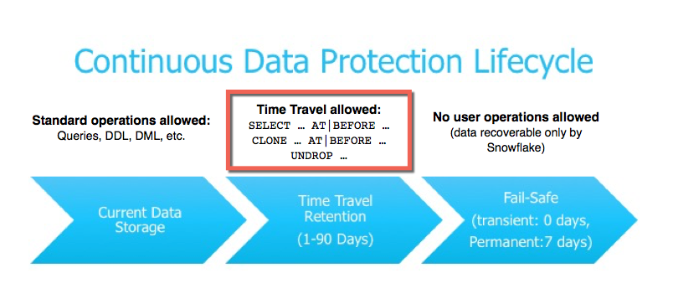
Time travel & Fail safe

Slide 10
LAB

Slide 11
Thank You

